Slide 1



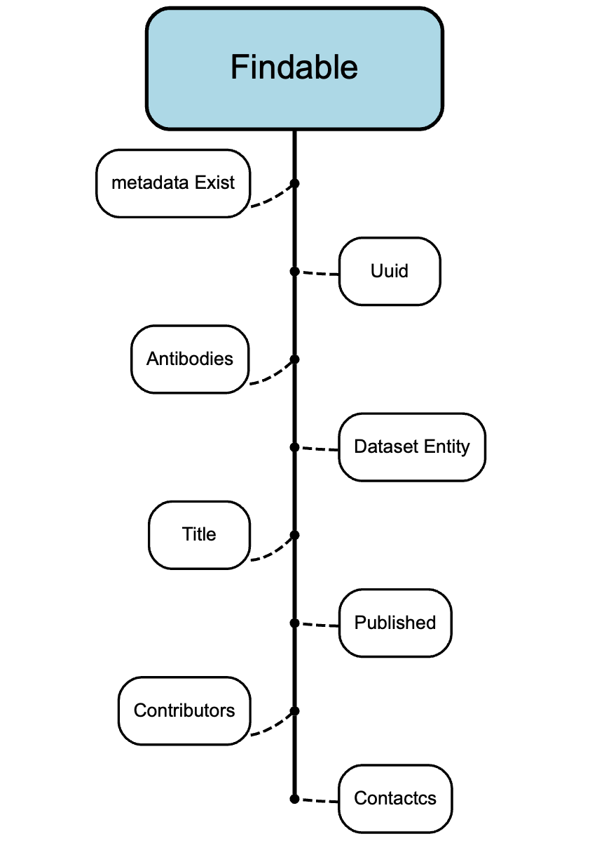
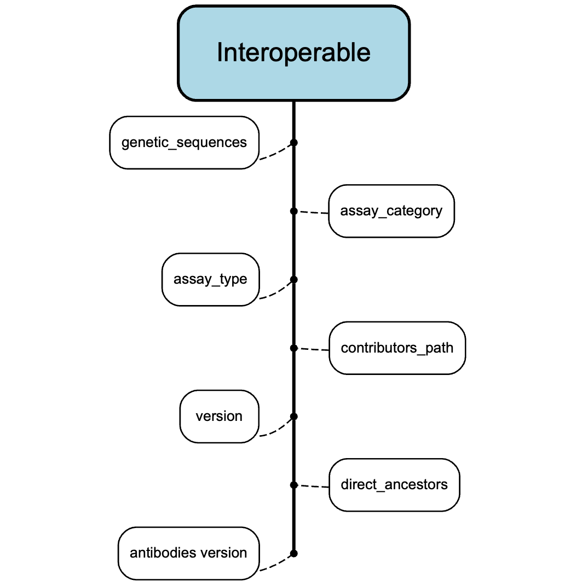
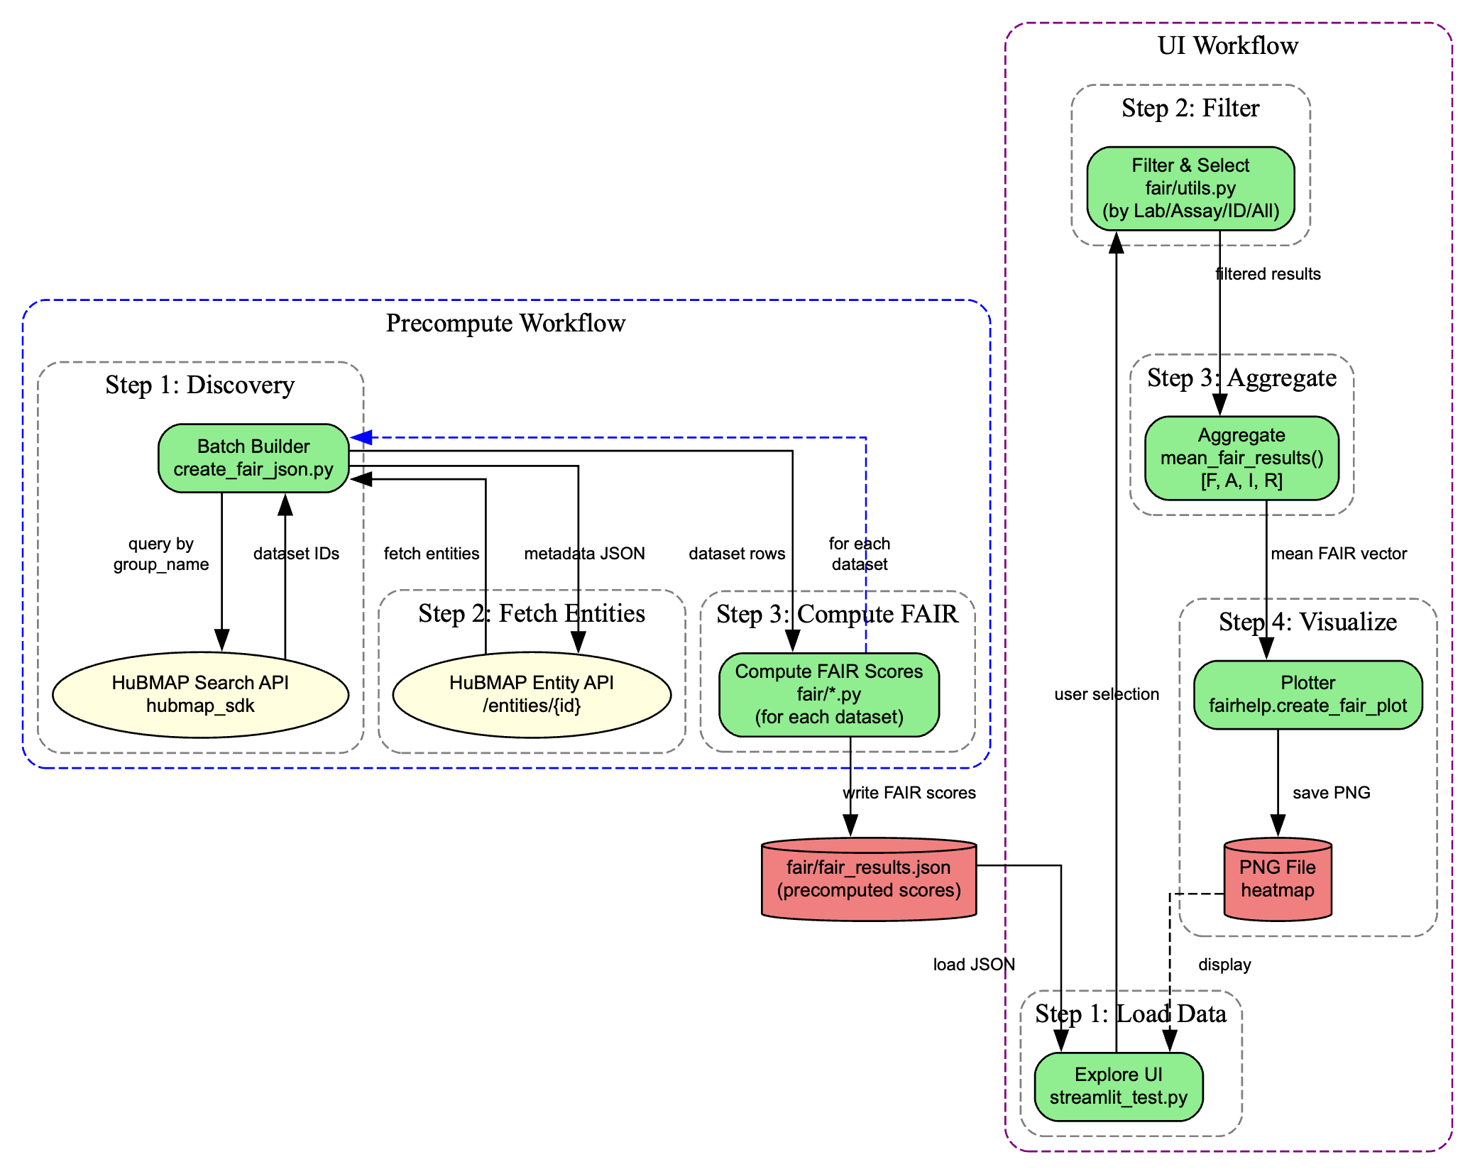
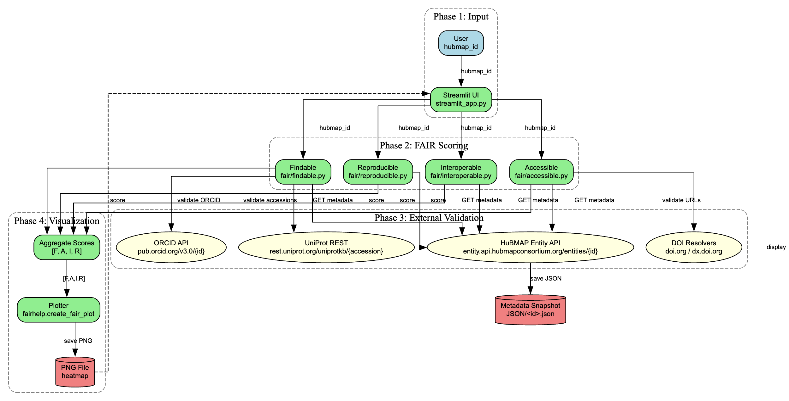
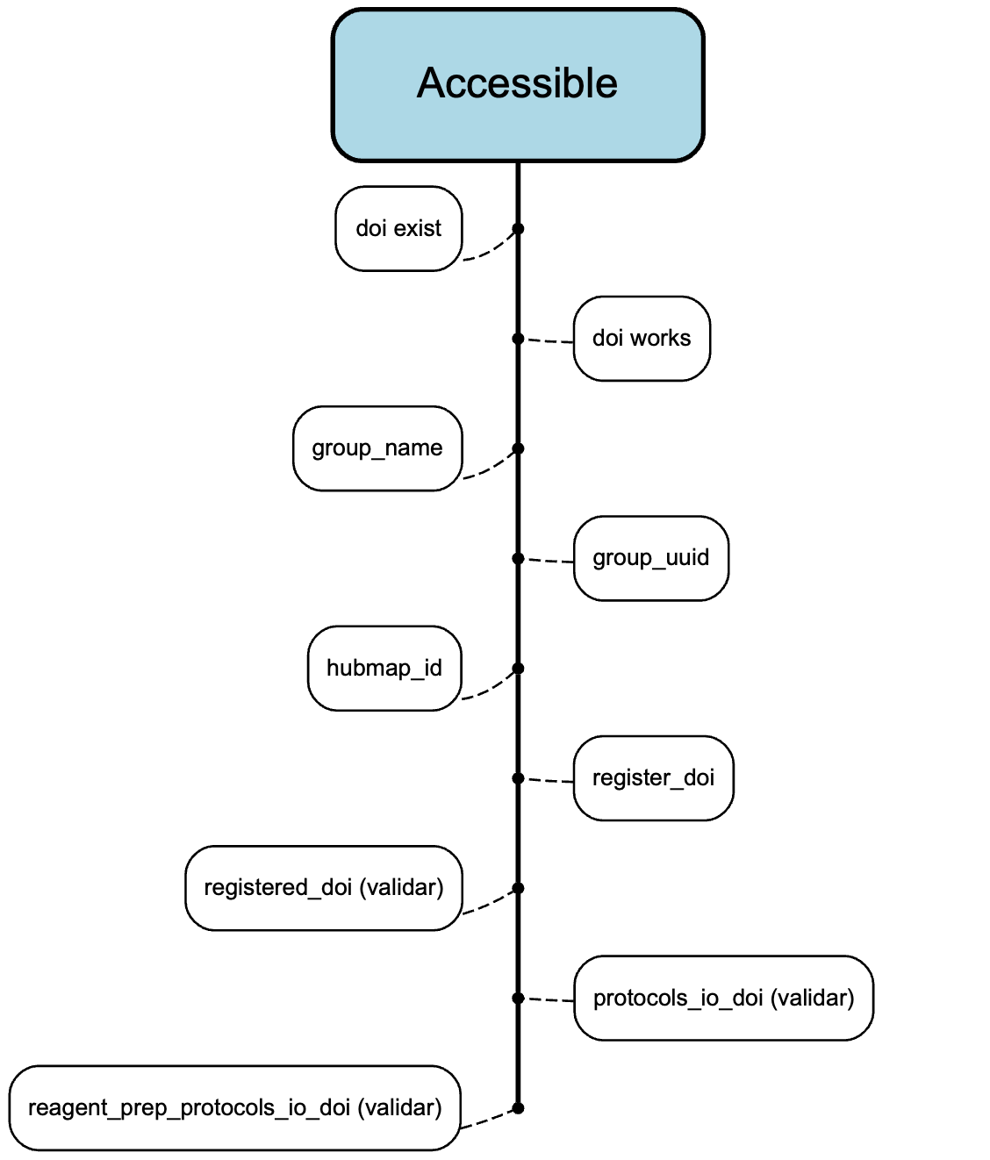
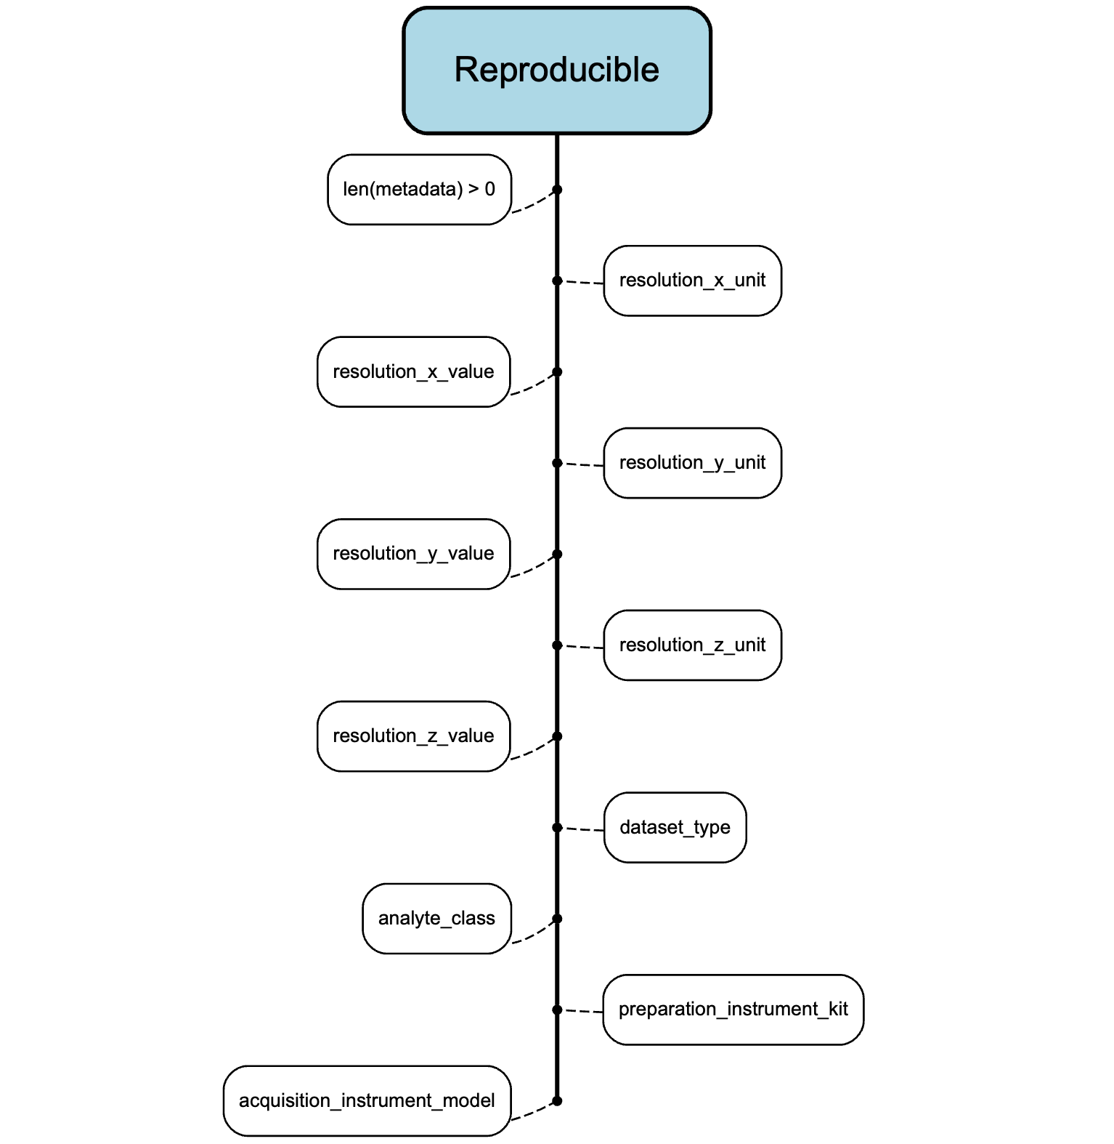
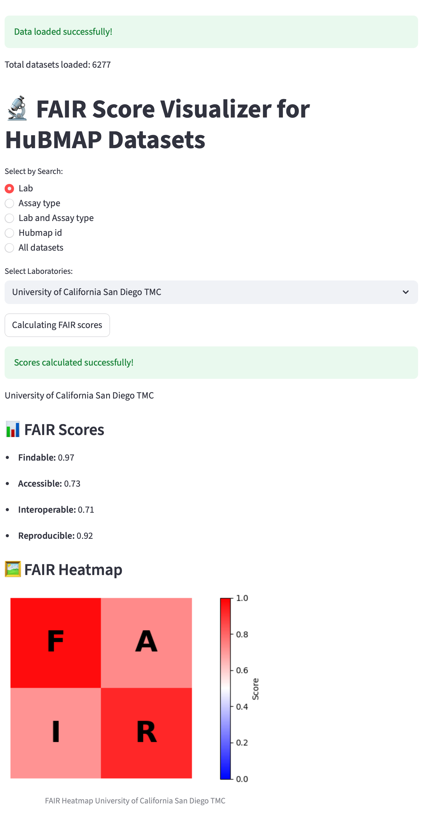
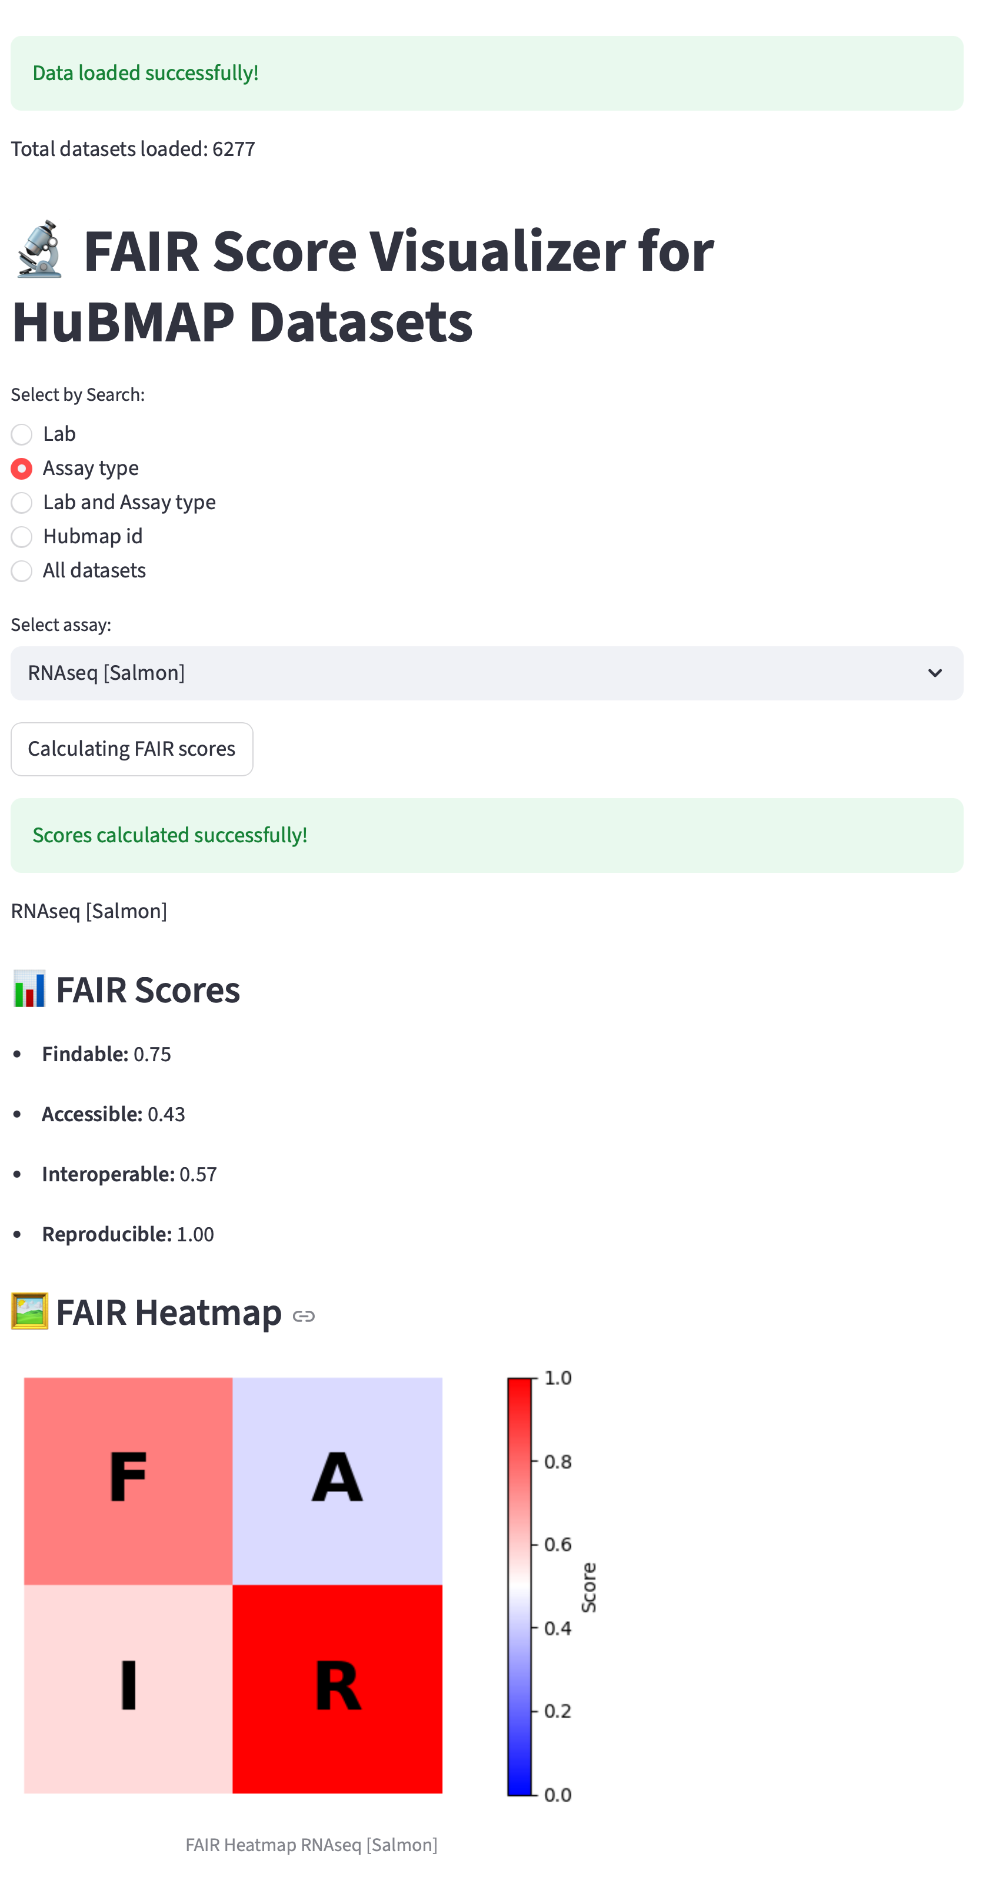
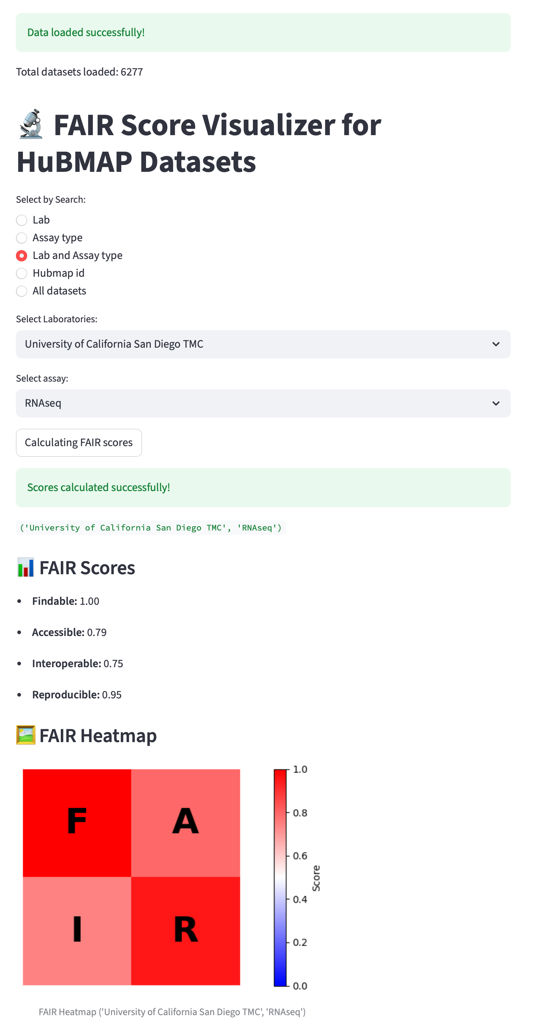
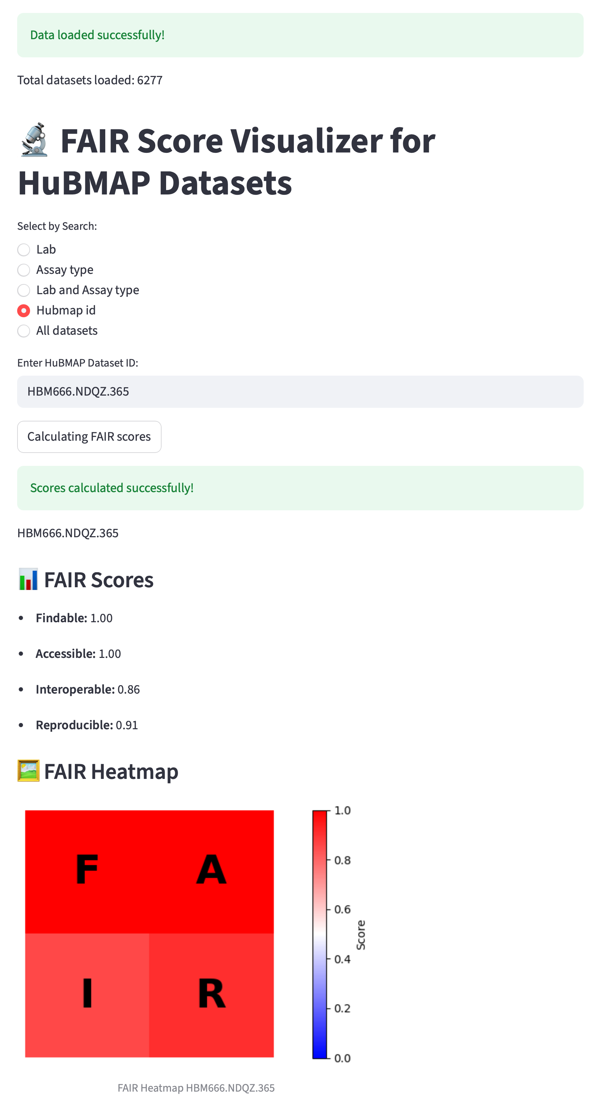
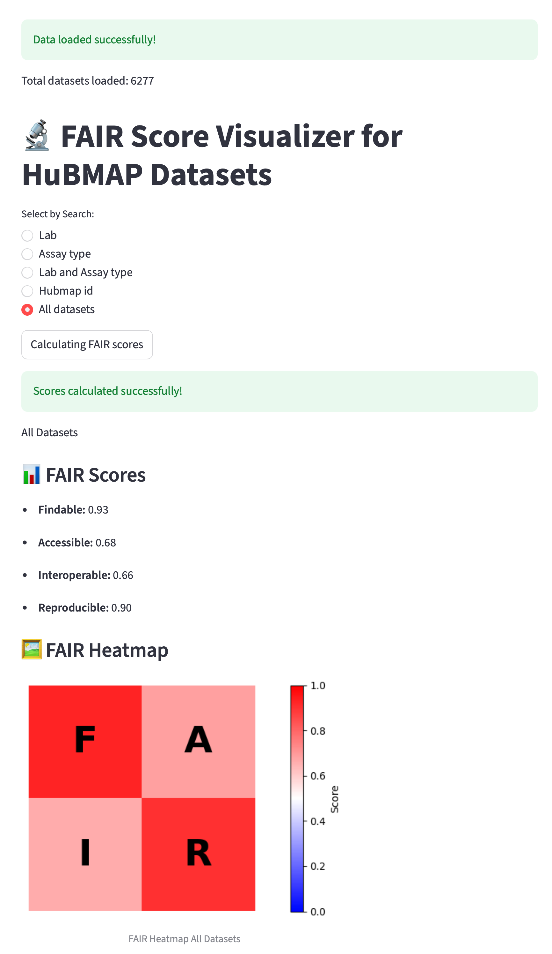
Developing, assessing and visualizing FAIR metrics for biomedical datasets in HuBMAP
Developing, assessing and visualizing FAIR metrics for biomedical datasets in HuBMAP
Eduardo J. Figueroa Santiago, Ivan Cao-Berg
Carnegie Mellon University
Pittsburgh Supercomputing Center,
University of Puerto Rico, Rio Piedras Campus
As science evolves, researchers face growing challenges in handling large-scale datasets, complex workflows, and effective visualization. The Human BioMolecular Atlas Program (HuBMAP) was developed to address these challenges by providing a central platform to store, analyze, and share data. However, making data available is not enough—ensuring that it is Findable, Accessible, Interoperable, and Reusable (FAIR) is critical for maximizing its value to the research community. The importance of FAIRness lies in transforming datasets from static collections into resources that can be reliably discovered, understood, and reused. In HuBMAP, FAIRness is not only a claim but a measurable quality. A key difficulty was the absence of a static list of FAIR metrics; existing resources offered only broad guidelines, and every project has unique needs. To address this, we reviewed published FAIRness frameworks, evaluated their criteria, and synthesized a set of tailored FAIR metrics for HuBMAP. These metrics were organized into the four FAIR categories—Findable, Accessible, Interoperable, and Reusable—and applied to the different dataset versions and assay types within the project. This framework enables assessment from multiple perspectives: Users can evaluate dataset quality without exposing sensitive information, Uploaders gain guidance on how to improve completeness and transparency for each dataset, Curators can verify gaps and track progress and Administrators can monitor overall FAIRness across the system. To complement the metrics, HuBMAP also incorporates graphical tools that display how datasets score within each FAIR category. These visualizations provide a clear overview of dataset performance and allow exploration by HuBMAP ID, by institution, or across the entire collection. In summary, FAIRness metrics in HuBMAP were designed and implemented to ensure data is not only available but also usable, transparent, and valuable for advancing biomedical research.
Abstract
Infrastructure Analysis
Infrastructure Overview
Conclusion
Final version of the FAIR Metrics
Introduction
Structure for checking the metrics
Connection of the structure
Future work
Results: Display FAIR Metrics
Addaping code to run automaticlly fo rhe calculations
Publically accessible in git repo
Imlementig AI for a deep dive on the understanding and a more reasonable weight distribution based on the importance of the features
Traing/Implement Ai in a generic solution of evalution of systerns, metrics and weights
Methodology/Technolgy
Search by Lab
Search by Assay Type
Search by Lab and Assay Type
Search by Hubmap id
Search all Datasets
Python Libraries(main libraries):
Python Libraries(main libraries):
Acknowledgements
Seaborn
Plotly
tqdm
Streamlit
Request
hubmap_sdk
Matplotlib
Pandas
Numpy
Github
Python
Bridges-2
I want to acknowledge the Carnegie Mellon University and the Pittsburgh Supercomputing Center for the opportunity to be part of the Summer internship program. Also to mentors and team I have worked with to prepare, organize and develop this Project.
Infrastructure analysis
Researching and Data Normalization
Preparing Metrics
Reference
FAIR structures different guidelines
Adapting FAIR structures to HUBMAP
Creating Multi assays evaluation
Creating Multi Version evaluation
Merging Data evaluation (all versions and all assays types)
Reviewing the merging Data of the evaluation
Creation FAIR Calculations Custom for HUBMAP
How to evaluate and scoring
Pre-computing calculations
Displaying Results
Bird, S., Dudík, M., Edgar, R., Horn, B., Lutz, R., Milan, V., Sameki, M., Wallach, H., Walker, K., & Design, A. (n.d.). Fairlearn: A toolkit for assessing and improving fairness in AI.
De Visser, C., Johansson, L. F., Kulkarni, P., Mei, H., Neerincx, P., Joeri Van Der Velde, K., Horvatovich, P., Van Gool, A. J., Swertz, M. A., Hoen, P. A. C. ‘T, & Niehues, A. (2023). Ten quick tips for building FAIR workflows. PLOS Computational Biology, 19(9), e1011369. https://doi.org/10.1371/journal.pcbi.1011369
Garcia, L., Batut, B., Burke, M. L., Kuzak, M., Psomopoulos, F., Arcila, R., Attwood, T. K., Beard, N., Carvalho-Silva, D., Dimopoulos, A. C., Del Angel, V. D., Dumontier, M., Gurwitz, K. T., Krause, R., McQuilton, P., Le Pera, L., Morgan, S. L., Rauste, P., Via, A., … Palagi, P. M. (2020). Ten simple rules for making training materials FAIR. PLOS Computational Biology, 16(5), e1007854. https://doi.org/10.1371/journal.pcbi.1007854
Garg, P., Villasenor, J., & Foggo, V. (2020). Fairness Metrics: A Comparative Analysis. 2020 IEEE International Conference on Big Data (Big Data), 3662–3666. https://doi.org/10.1109/BigData50022.2020.9378025
HuBMAP Consortium, Writing Group, Snyder, M. P., Lin, S., Posgai, A., Atkinson, M., Regev, A., Rood, J., Rozenblatt-Rosen, O., Gaffney, L., Hupalowska, A., Satija, R., Gehlenborg, N., Shendure, J., Laskin, J., Harbury, P., Nystrom, N. A., Silverstein, J. C., Bar-Joseph, Z., … Anderson, J. (2019). The human body at cellular resolution: The NIH Human Biomolecular Atlas Program. Nature, 574(7777), 187–192. https://doi.org/10.1038/s41586-019-1629-x
Johnson, B., & Brun, Y. (2022). Fairkit-learn: A fairness evaluation and comparison toolkit. Proceedings of the ACM/IEEE 44th International Conference on Software Engineering: Companion Proceedings, 70–74. https://doi.org/10.1145/3510454.3516830
Krans, N. A., Ammar, A., Nymark, P., Willighagen, E. L., Bakker, M. I., & Quik, J. T. K. (2022). FAIR assessment tools: Evaluating use and performance. NanoImpact, 27, 100402. https://doi.org/10.1016/j.impact.2022.100402
Vogt, L., Kuhn, T., & Hoehndorf, R. (2024). Semantic units: Organizing knowledge graphs into semantically meaningful units of representation. Journal of Biomedical Semantics, 15(1), 7. https://doi.org/10.1186/s13326-024-00310-5
Wilkinson, M. D., Dumontier, M., Aalbersberg, Ij. J., Appleton, G., Axton, M., Baak, A., Blomberg, N., Boiten, J.-W., Da Silva Santos, L. B., Bourne, P. E., Bouwman, J., Brookes, A. J., Clark, T., Crosas, M., Dillo, I., Dumon, O., Edmunds, S., Evelo, C. T., Finkers, R., … Mons, B. (2016). The FAIR Guiding Principles for scientific data management and stewardship. Scientific Data, 3(1), 160018. https://doi.org/10.1038/sdata.2016.18
Wilkinson, M. D., Sansone, S.-A., Schultes, E., Doorn, P., Bonino Da Silva Santos, L. O., & Dumontier, M. (2018). A design framework and exemplar metrics for FAIRness. Scientific Data, 5(1), 180118. https://doi.org/10.1038/sdata.2018.118

